Slide 1
Dis 01:
Control + Environments
TA: Anita Cu
anitacu5@berkeley.edu

Slide 2
Agenda
0 ) Administrivia
1 ) Control
2 ) Environment Diagrams

Slide 3
Administrivia
OH on Thursdays 1-2 pm @ 109 Morgan
Check out https://cs61a.org/office-hours.html for all OH times!
Lab 00 and Lab 01 due tonight 2/1

Slide 4
Administrivia
Project 1 - Hog is released!
Phase 1 (individual) due 2/5
Phase 2 + 3 (individual or in pairs) due 2/7
If complete entire project by 2/6, receive 1 point extra credit
Project Party on 2/4

Slide 5
1
Control

Slide 6
Control
Directs flow of logic in code

Slide 7
if-elif-else
if <condition1>:
# if <condition1> is True, go here
elif <condition2>:
# if <condition2> is True, go here
else:
# otherwise, go here

Slide 8
if-elif-else
if <condition1>:
# if <condition1> is True, go here
elif <condition2>:
# if <condition2> is True, go here
else:
# otherwise, go here
elif, else are optional
can have multiple elif clauses

Slide 9
if-elif-else
I’m on my way to 61A discussion from Cory Hall and it’s already 11:09 am!

Slide 10
if-elif-else
I’m on my way to 61A discussion from Cory Hall and it’s already 11:09 am!
if I run to class:

Slide 11
if-elif-else
I’m on my way to 61A discussion from Cory Hall and it’s already 11:09 am!
if I run to class:
# I will be on time

Slide 12
if-elif-else
I’m on my way to 61A discussion from Cory Hall and it’s already 11:09 am!
if I run to class:
# I will be on time
else:

Slide 13
if-elif-else
I’m on my way to 61A discussion from Cory Hall and it’s already 11:09 am!
if I run to class:
# I will be on time
else:
# I will be late :(

Slide 14
Truthy/Falsey Values
False values: False, 0, None, “”, [ ] (empty string, empty list)
True values: everything else!

Slide 15
Short Circuiting
short-circuiting: stop evaluating operands when there is enough info to make a decision!

Slide 16
Short Circuiting
short-circuiting: stop evaluating operands when there is enough info to make a decision!
if still evaluate all operands and do not short-circuit, will return the last value (which is not always True or False)!

Slide 17
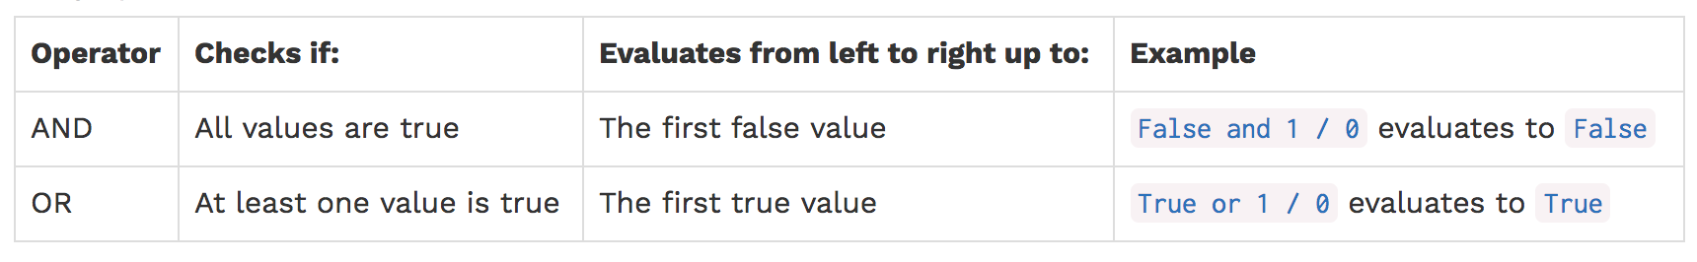
Short Circuiting
short-circuiting: stop evaluating operands when there is enough info to make a decision!
if still evaluate all operands and do not short-circuit, will return the last value (which is not always True or False)!

Slide 18
Boolean Operators
and
short-circuits once it reaches first false value and returns it
if all values evaluate to true values, return the last value

Slide 19
Boolean Operators
and
short-circuits once it reaches first false value and returns it
if all values evaluate to true values, return the last value
> 5 and 0 and 1/0

Slide 20
Boolean Operators
and
short-circuits once it reaches first false value and returns it
if all values evaluate to true values, return the last value
> 5 and 0 and 1/0
0

Slide 21
Boolean Operators
and
short-circuits once it reaches first false value and returns it
if all values evaluate to true values, return the last value
> 5 and 0 and 1/0
0
or
short-circuits once it reaches the first true value and returns it
if all values evaluate to false values, return the last value

Slide 22
Boolean Operators
and
short-circuits once it reaches first false value and returns it
if all values evaluate to true values, return the last value
> 5 and 0 and 1/0
0
or
short-circuits once it reaches the first true value and returns it
if all values evaluate to false values, return the last value
> 5 or 0 or 1/0

Slide 23
Boolean Operators
and
short-circuits once it reaches first false value and returns it
if all values evaluate to true values, return the last value
> 5 and 0 and 1/0
0
or
short-circuits once it reaches the first true value and returns it
if all values evaluate to false values, return the last value
> 5 or 0 or 1/0
5

Slide 24
Boolean Operators
Order of priority: not > and > or
evaluate not first
then and
then or

Slide 25
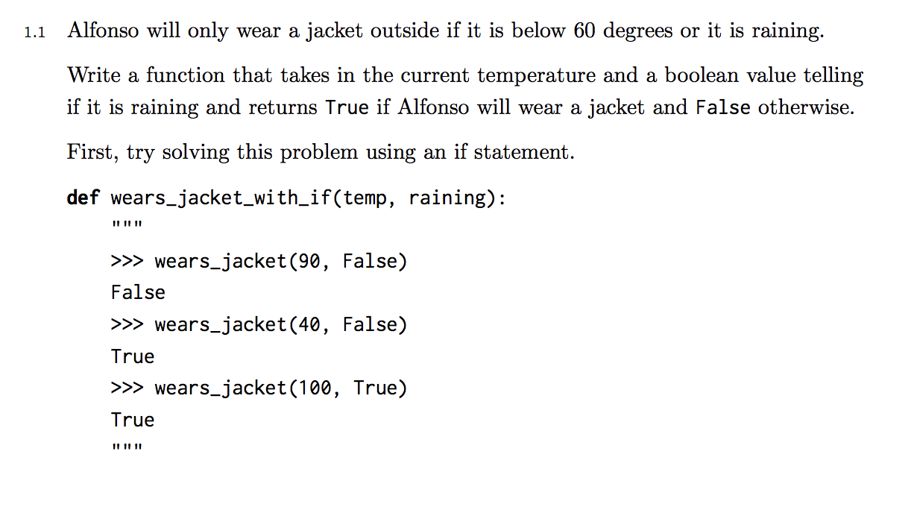
Practice 1.1

Slide 26
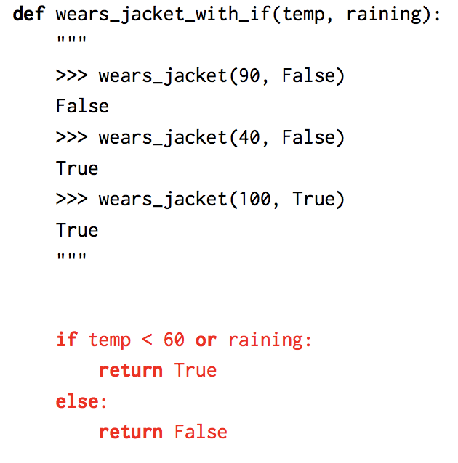
Practice 1.1 Solution

Slide 27
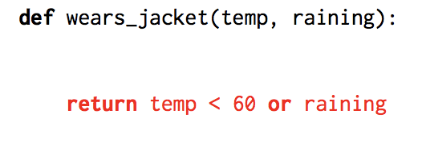
Practice 1.1 Solution

Slide 28
while
while <condition>:
# repeat this while <condition> is True
stop once <condition> is no longer satisfied

Slide 29
while
Say I have 20 peanut M&Ms sitting on my desk

Slide 30
while
Say I have 20 peanut M&Ms sitting on my desk
While there are still peanut M&Ms, I want to eat one

Slide 31
while
Say I have 20 peanut M&Ms sitting on my desk
While there are still peanut M&Ms, I want to eat one
Can demonstrate using a while loop

Slide 32
while
Say I have 20 peanut M&Ms sitting on my desk
while numberOfPeanutM&Ms > 0:
# eat a peanut M&M
numberOfPeanutM&Ms -= 1

Slide 33
while
Say I have 20 peanut M&Ms sitting on my desk
while numberOfPeanutM&Ms > 0:
# eat a peanut M&M
numberOfPeanutM&Ms -= 1
How many iterations does this loop have?
(How many times do I eat a peanut M&M?)

Slide 34
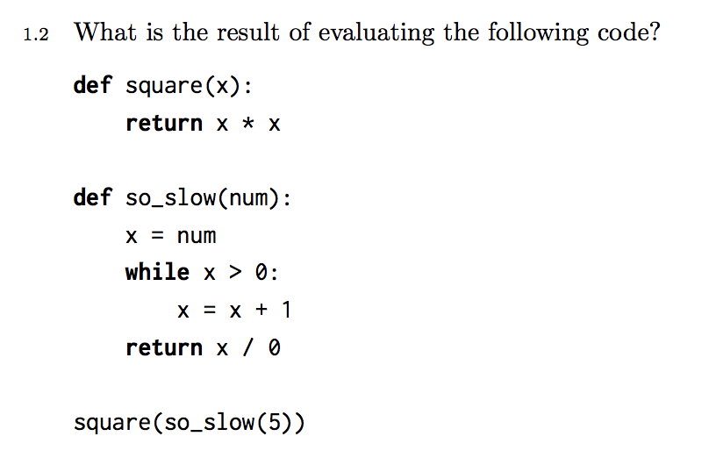
Practice 1.2

Slide 35
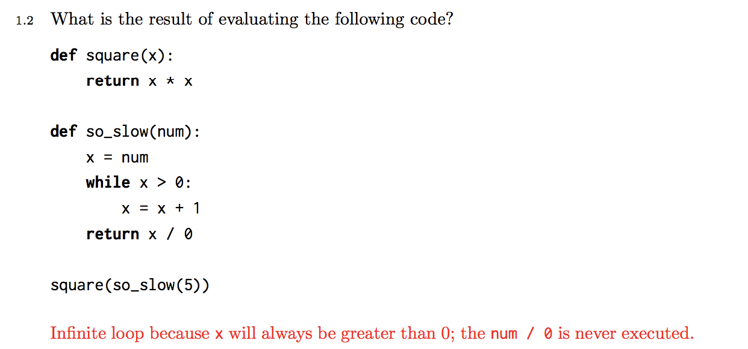
Practice 1.2 Solution

Slide 36

Be aware of infinite loops!
Make sure for while loops, you have a conditional expression that eventually terminates or else your code will run infinitely! :o

Slide 37
Be aware of infinite loops!
Make sure for while loops, you have a conditional expression that eventually terminates or else your code will run infinitely! :o
Can do this by reducing some counter that approaches the condition
E.g. numberOfPeanutM&Ms -= 1

Slide 38
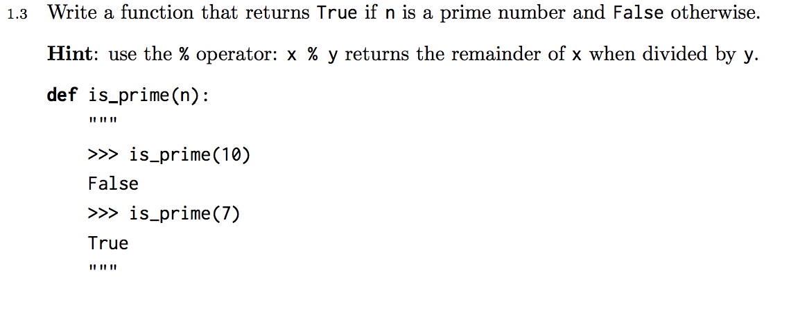
Practice 1.3

Slide 39
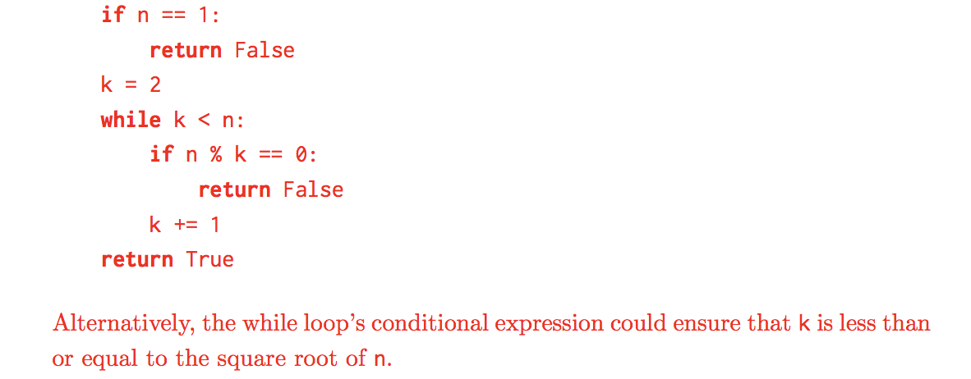
Practice 1.3 Solution

Slide 40
2
Environment Diagrams

Slide 41
Environment Diagrams
environment diagram: stores the variable names defined and the values they’ve been binded to so that you can look up easily

Slide 42
Environment Diagrams
environment diagram: stores the variable names defined and the values they’ve been binded to so that you can look up easily
Executing assignment statements
x = 3

Slide 43
Environment Diagrams
environment diagram: stores the variable names defined and the values they’ve been binded to so that you can look up easily
Executing assignment statements
x = 3
Executing def statements (defining functions)
def square(x):
return x ** 2

Slide 44
Environment Diagrams
environment diagram: stores the variable names defined and the values they’ve been binded to so that you can look up easily
Executing assignment statements
x = 3
Executing def statements (defining functions)
def square(x):
return x ** 2
Executing call expressions
square(2)

Slide 45
Environment Diagrams
environment diagram: stores the variable names defined and the values they’ve been binded to so that you can look up easily
Executing assignment statements
x = 3
Executing def statements (defining functions)
def square(x):
return x ** 2
Executing call expressions
square(2)
If a function does not have a return value, by default returns None

Slide 46
Demo
https://goo.gl/ks9jJB

Slide 47
Executing Assignment Statements
x = 3

Slide 48
Executing Assignment Statements
x = 3
Use variable names so you can store data in a name
and reference it later

Slide 49
Executing Assignment Statements
x = 3
Use variable names so you can store data in a name
and reference it later
Steps to execute assignment statements:

Slide 50
Executing Assignment Statements
x = 3
Use variable names so you can store data in a name
and reference it later
Steps to execute assignment statements:
1. Evaluate expression to the right of “=”

Slide 51
Executing Assignment Statements
x = 3
Use variable names so you can store data in a name
and reference it later
Steps to execute assignment statements:
1. Evaluate expression to the right of “=”
2. Assign the variable name (on the left of the “=”) to the value evaluated from the right side in the current frame

Slide 52
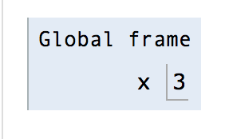
Executing Assignment Statements
x = 3
Use variable names so you can store data in a name
and reference it later
Steps to execute assignment statements:
1. Evaluate expression to the right of “=”
2. Assign the variable name (on the left of the “=”) to the value evaluated from the right side in the current frame

Slide 53
Executing Assignment Statements
x = 3
Use variable names so you can store data in a name
and reference it later
Steps to execute assignment statements:
1. Evaluate expression to the right of “=”
2. Assign the variable name (on the left of the “=”) to the value evaluated from the right side in the current frame
year = 2*1000+20-1
binds variable name to value, not expression, so year evaluates to 2019

Slide 54
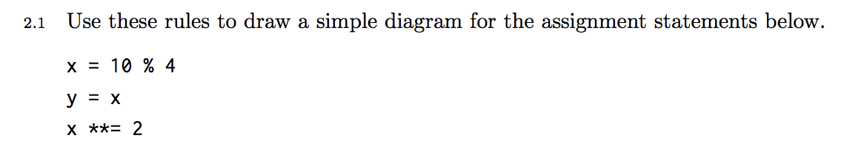
Practice 2.1

Slide 55
Practice 2.1 Solution
Solution: https://goo.gl/mjfnMn

Slide 56
Executing def Statements
def square(x):
return x ** 2

Slide 57
Executing def Statements
def square(x):
return x ** 2
Creates a function object + binds to a name

Slide 58
Executing def Statements
def square(x):
return x ** 2
Creates a function object + binds to a name
Steps to execute def statements:

Slide 59
Executing def Statements
def square(x):
return x ** 2
Creates a function object + binds to a name
Steps to execute def statements:
Draw a function object denoting its intrinsic name, its parameters, and parent frame (where the function was defined)
func square(x) [parent=Global]

Slide 60
Executing def Statements
def square(x):
return x ** 2
Creates a function object + binds to a name
Steps to execute def statements:
Draw a function object denoting its intrinsic name, its parameters, and parent frame (where the function was defined)
func square(x) [parent=Global]
Write the function name in the current frame and draw an arrow from the name to the function object

Slide 61
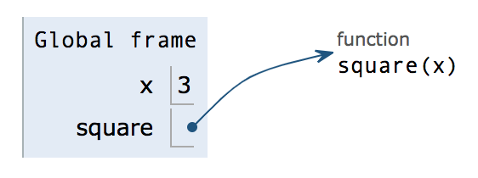
Executing def Statements
def square(x):
return x ** 2
[parent = Global]
Creates a function object + binds to a name
Steps to execute def statements:
Draw a function object denoting its intrinsic name, its parameters, and parent frame (where the function was defined)
func square(x) [parent=Global]
Write the function name in the current frame and draw an arrow from the name to the function object

Slide 62
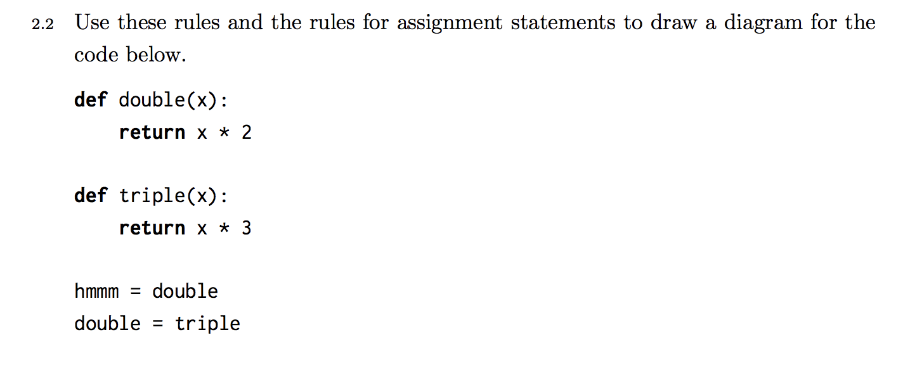
Practice 2.2

Slide 63
Practice 2.2 Solution
Solution: https://goo.gl/rmjbKd

Slide 64
Executing Call Expressions
square(2)

Slide 65
Executing Call Expressions
Every time you make a function call, create a new frame
to keep track of local variables in that frame!
square(2)

Slide 66
Executing Call Expressions
Every time you make a function call, create a new frame
to keep track of local variables in that frame!
Steps to execute a call expression:
square(2)

Slide 67
Executing Call Expressions
Every time you make a function call, create a new frame
to keep track of local variables in that frame!
Steps to execute a call expression:
square(2)
1. Evaluate the operator (the function).

Slide 68
Executing Call Expressions
Every time you make a function call, create a new frame
to keep track of local variables in that frame!
Steps to execute a call expression:
square(2)
1. Evaluate the operator (the function).
2. Evaluate the operands from left to right.

Slide 69
Executing Call Expressions
Every time you make a function call, create a new frame
to keep track of local variables in that frame!
Steps to execute a call expression:
square(2)
1. Evaluate the operator (the function).
2. Evaluate the operands from left to right.
3. Draw new frame and label it with
A unique index (f1, f2, ...)
The intrinsic name of the function/operator from step #1
The parent frame

Slide 70
Executing Call Expressions
Every time you make a function call, create a new frame
to keep track of local variables in that frame!
Steps to execute a call expression:
square(2)
1. Evaluate the operator (the function).
2. Evaluate the operands from left to right.
3. Draw new frame and label it with
A unique index (f1, f2, ...)
The intrinsic name of the function/operator from step #1
The parent frame
4. Bind formal parameters to the operands/args passed in from #2.

Slide 71
Executing Call Expressions
Every time you make a function call, create a new frame
to keep track of local variables in that frame!
Steps to execute a call expression:
square(2)
1. Evaluate the operator (the function).
2. Evaluate the operands from left to right.
3. Draw new frame and label it with
A unique index (f1, f2, ...)
The intrinsic name of the function/operator from step #1
The parent frame
4. Bind formal parameters to the operands/args passed in from #2.
5. Evaluate body of function with these arguments.

Slide 72
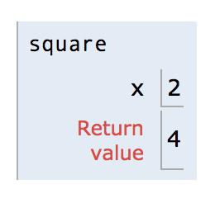
Executing Call Expressions
Every time you make a function call, create a new frame
to keep track of local variables in that frame!
Steps to execute a call expression:
square(2)
f1:
[parent = Global]
1. Evaluate the operator (the function).
2. Evaluate the operands from left to right.
3. Draw new frame and label it with
A unique index (f1, f2, ...)
The intrinsic name of the function/operator from step #1
The parent frame
4. Bind formal parameters to the operands/args passed in from #2.
5. Evaluate body of function with these arguments.

Slide 73
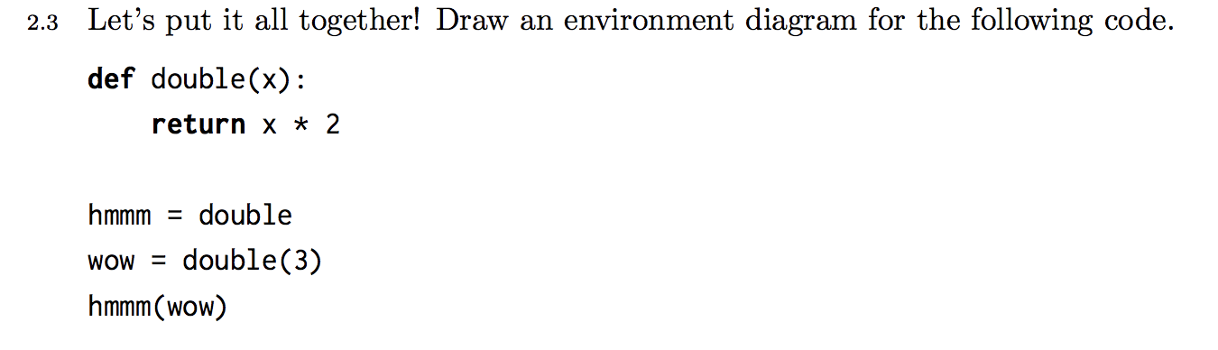
Practice 2.3

Slide 74
Practice 2.3 Solution
Solution: https://goo.gl/jM37t7

Slide 75
Python Tutor
Practice drawing environment diagrams
Very helpful tool to visualize/check your work
http://pythontutor.com/

Slide 76
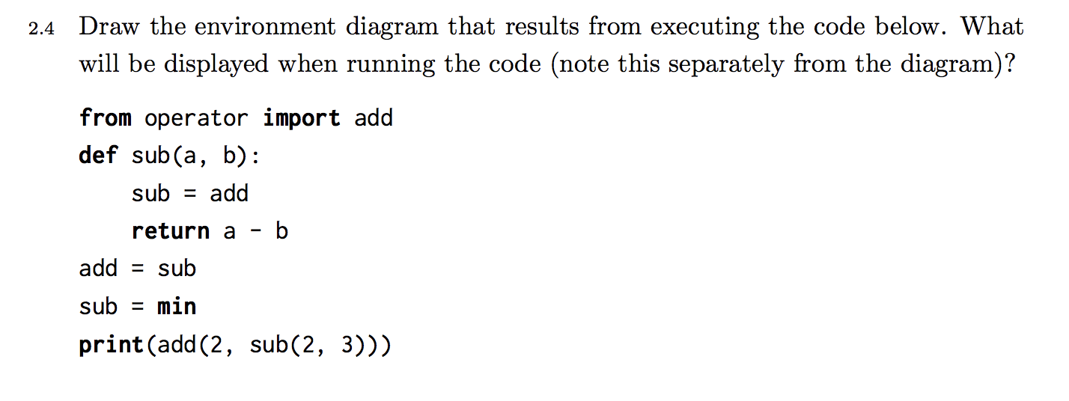
Practice 2.4

Slide 77
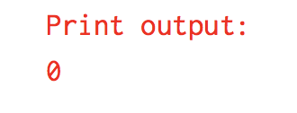
Practice 2.4 Solution
Solution: https://goo.gl/XCZrXp

Slide 78
Attendance Form!
https://tinyurl.com/ycon9n6x

Slide 79
Introduction Survey
https://tinyurl.com/yamq5gtl
If you didn’t fill out the intro survey last week, please fill this out so I can learn more about you and how you learn best!

